Slide 1
CIS 5560 – Introduction to Big data Machine learning
MICROSOFT AZURE MACHINE LEARNING &
DATABRICKS

Slide 2
PRESENTED BY – (GROUP D)
RUCHITA SHINDE (306615886)
NIKITA SHENDKAR (306615938)
SHAHNAWAZ KHAN
SOHONG CHAKRABORTY (306628834)

Slide 3
Data set specifications
NATIONAL STOCK EXCHANGE OF INDIA
LINK (https://www.kaggle.com/ramamet4/nse-company-stocks/data)
CONTENTS: nseComp.1.csv
SIZE OF THE DATA: 1.86 GB

Slide 4
HOMEWORK EXPERIMENTAL SPECIFICATIONS
Data Brick Specifications:
Execution: Single Node
Memory: 6 GB Capacity
Databricks Runtime Version: 4.0 (Incl. Apache Spark 2.3.0, Scala 2.11)
Microsoft Azure Machine Learning Studio Specification:
Execution: Single Node
Storage Space Capacity: 10 GB Memory
Computer Resource Type: ML Service is a multitenant service

Slide 5
INTRODUCTION
WHAT IS NSE?
THE NATIONAL STOCK EXCHANGE (NSE) IS THE LEADING STOCK EXCHANGE IN INDIA AND THE FOURTH LARGEST IN THE WORLD BY EQUITY TRADING VOLUME IN 2015, ACCORDING TO WORLD FEDERATION OF EXCHANGES (WFE).
IN THIS STUDY, LARGE NUMBER OF NATIONAL STOCK EXCHANGE (NSE), INDIA STOCKS UNDER DIFFERENT SECTORS ARE MINED FROM VARIOUS FINANCIAL WEBSITES AND DATA ANALYTIC STEPS ARE FOLLOWED.
PRIMARY GOAL OF THIS WORK IS TO EXPLORE THE HIDDEN CONTEXT PATTERNS BETWEEN DIVERSE GROUP OF STOCKS AND DISCOVER THE PREDICTIVE ANALYTIC KNOWLEDGE USING MACHINE LEARNING ALGORITHMS.

Slide 6
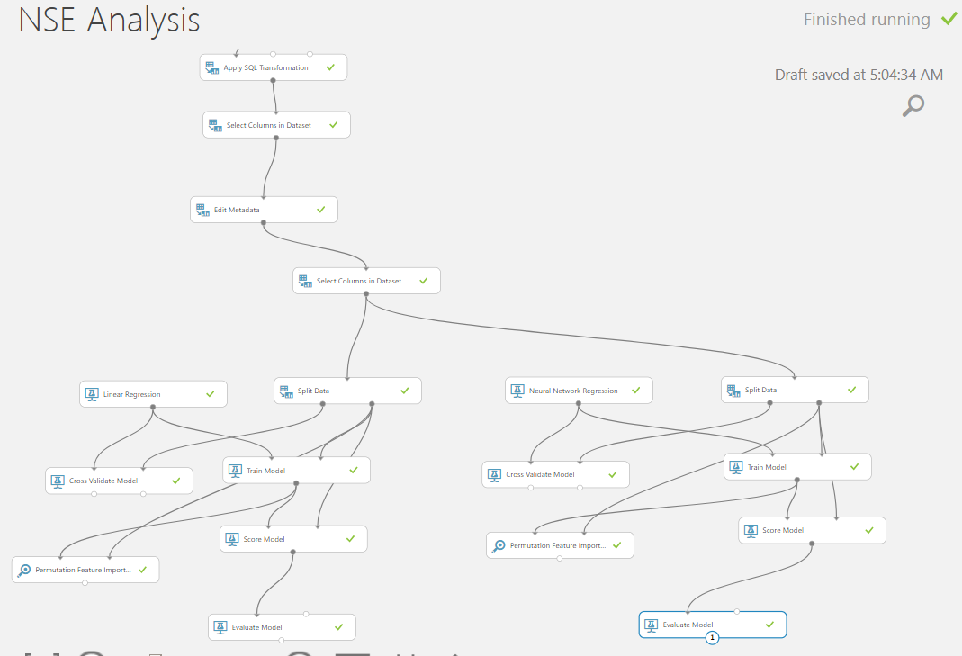
MICROSOFT AZURE MACHINE LEARNING STUDIO

Slide 7
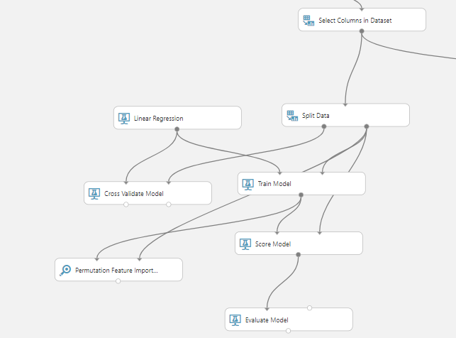
MODEL WITH LINEAR REGRESSION

Slide 8
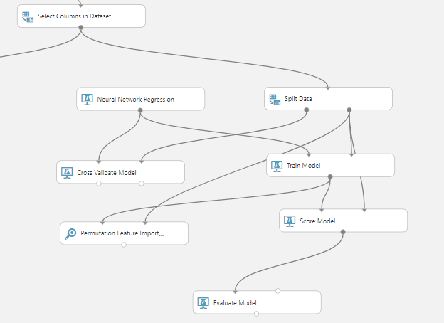
MODEL WITH NEURAL NETWORK REGRESSION

Slide 9
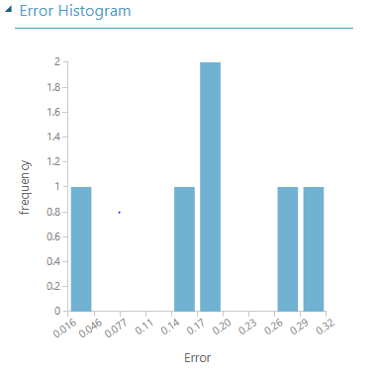
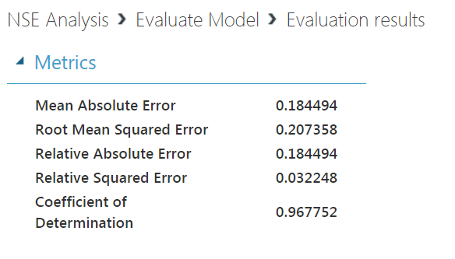
LINEAR REGRESSION

Slide 10
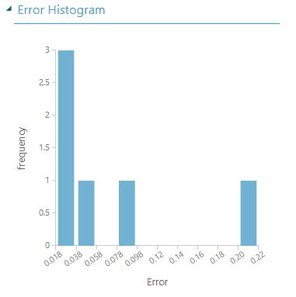
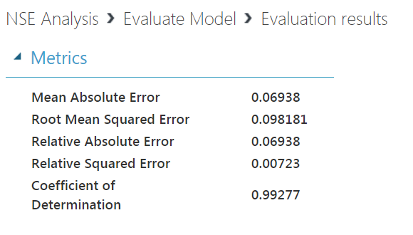
NEURAL NETWORK REGRESSION

Slide 11


THE FILE SIZE IS 38.6 MB and the run time was 2.15 MINUTES OUR MODEL WITH NEURAL NETWORK REGRESSION IS BETTER IN MICROSOFT AZURE ML PLATFORM
MODEL WITH LINEAR REGRESSION
MODEL WITH NEURAL NETWORK REGRESSION

Slide 12
DATABRICKS PySPARK FILE SIZE: 1.86 GB RUN TIME OF PIPELINE: 3.5 HOURS

Slide 13
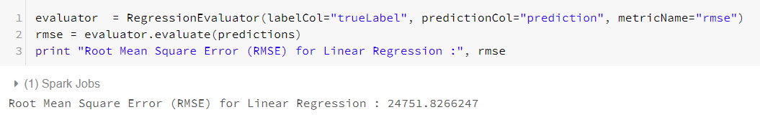
DATA BRICKS (SPARK MACHINE LEARNING)
MODEL 1:
ALGORITHM USED: LINEAR REGRESSION
SPLIT DATA: 0.7, 0.3
ROOT MEAN SQUARE ERROR : 24751.8266

Slide 14
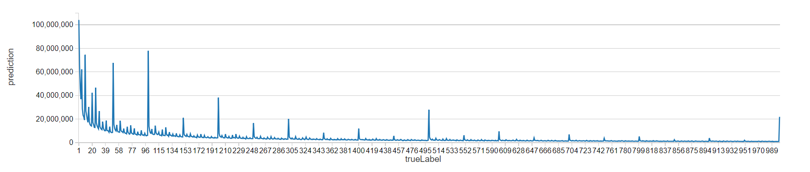
GRAPH ACHIEVED BY USING LINEAR REGRESSION

Slide 15
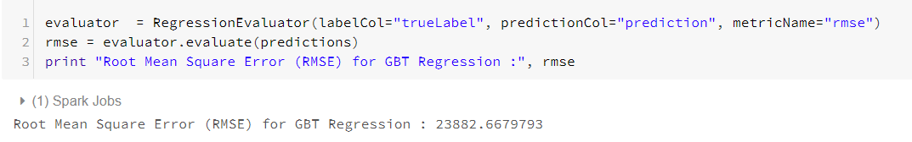
MODEL 2:
ALGORITHM USED: GRADIENT BOOSTED TREE REGRESSION
ROOT MEAN SQUARE ERROR: 23882.667

Slide 16
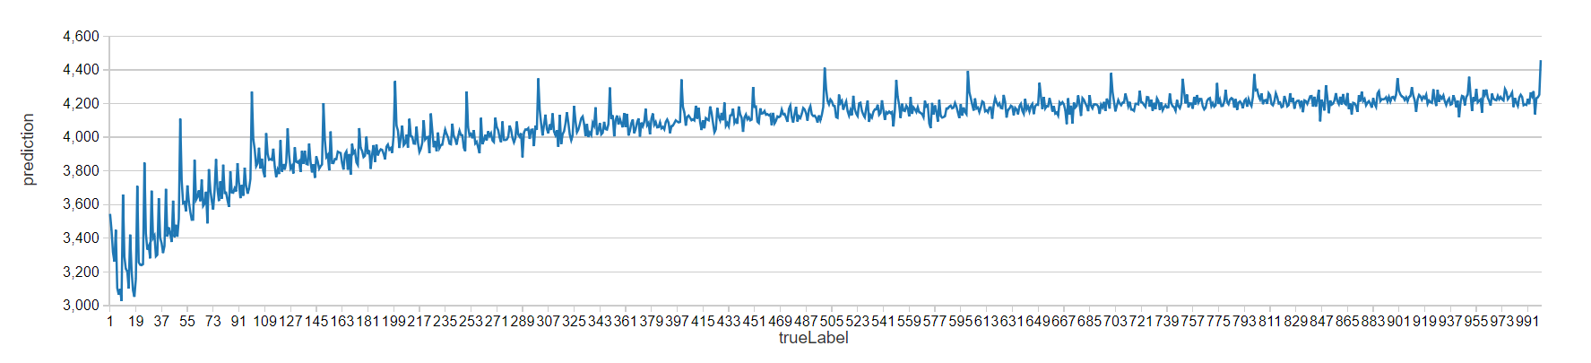
GRAPH ACHIEVED BY USING GRADIENT BOOSTED TREE REGRESSION

Slide 17
LINEAR REGRESSION:
GRADIENT BOOSTED TREE REGRESSION:

Slide 18
MICROSOFT AZURE ML STUDIO
MODEL WITH NEURAL NETWORK REGRESSION:
MODEL WITH LINEAR REGRESSION:
DATABRICKS
LINEAR REGRESSION:
GRADIENT BOOSTED TREE REGRESSION:

Slide 19
CONCLUSION
NSE USES THE DATA FOR :
PREDICTION AFFECTS THE CURRENT STOCK PRICE
FORECAST THE RANGE AND DIRECTION OF INDIAN STOCK FLUCTUATIONS
ASSESS THE EFFECT OF PARTICULAR ISSUES AND EVENTS ON OVERALL MARKET MOVEMENTS

Slide 20
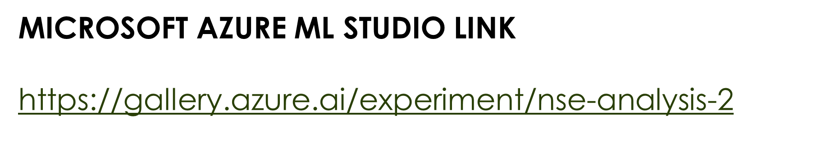
GITHUB LINK https://github.com/sohong16/CIS-5560---Introduction-to-Big-Data

Slide 21
REFERENCES:
1. https://docs.databricks.com/spark/latest/mllib/decision-trees.html#gbt-regression-using-mllib-pipelines
2. https://docs.databricks.com/spark/latest/mllib/mllib-pipelines-and-stuctured-streaming.html
3. https://docs.microsoft.com/en-us/azure/machine-learning/studio-module-reference/machine-learning-modules
4. https://docs.microsoft.com/en-us/azure/machine-learning/desktop-workbench/data-prep-python-extensibility-overview

Slide 22
QUESTIONS?

